Slide 1
MIAU Project Tracker
Scope of project

Slide 2
Purpose
The purpose of the project tracker is to give us a way to visually track projects and workload of team members.
It will allow team members to see where resource is available for upcoming projects, and assist them in managing their time.
It produces a summary dashboard to display key statistics and KPIs e.g. how many projects currently have a QA log

Slide 3
Current work
The project tracker in it’s current form was developed by Lizzie Greenwood. It has not been updated since February and contains many out-of-date details.
The app has been created in R-Shiny.
Information can be entered into the app itself or can be entered into a separate database and then read into the app.

Slide 4
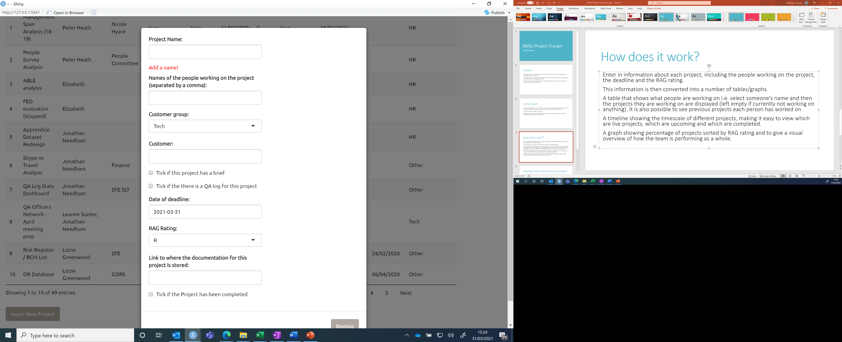
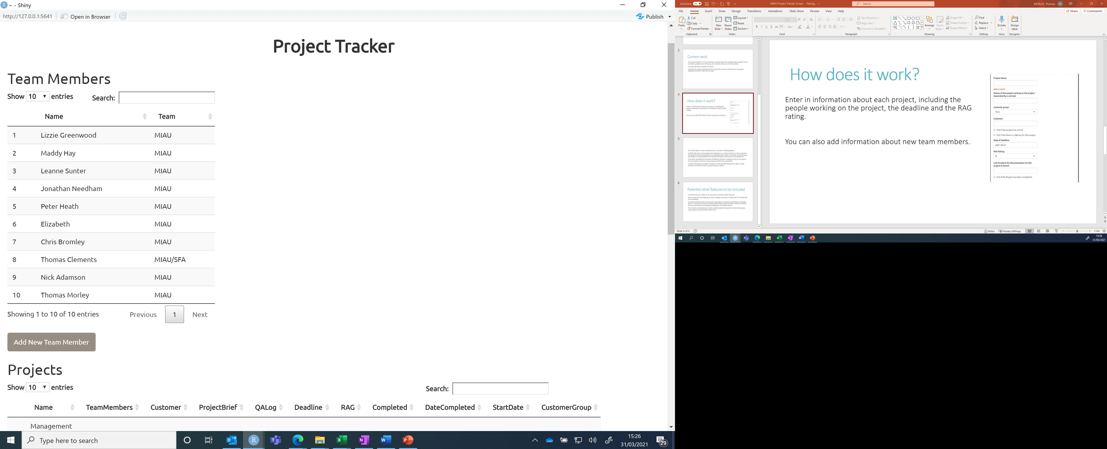
How does it work?
Enter in information about each project, including the people working on the project, the deadline and the RAG rating.
You can also add information about new team members.

Slide 5
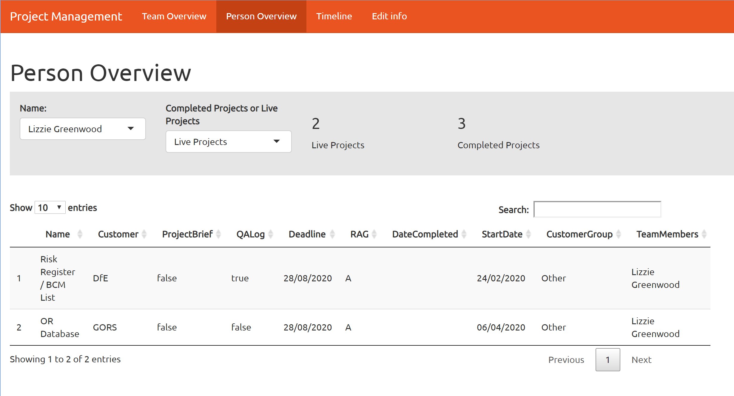
How does it work?
This information is then converted into a number of tables/graphs.
A table that shows what people are working on i.e. select someone’s name and then the projects they are working on are displayed (left empty if currently not working on anything). It is also possible to see previous projects each person has worked on.

Slide 6
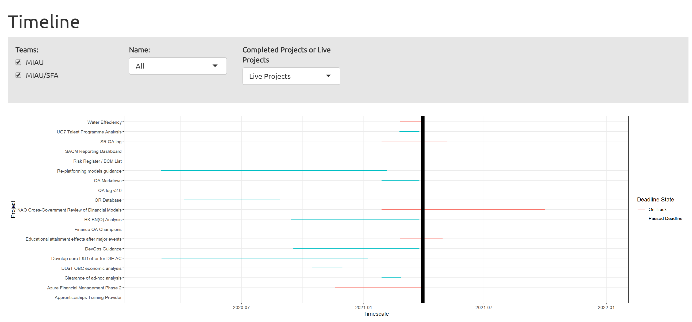
How does it work?
A timeline showing the timescale of different projects, making it easy to view which are live projects, which are upcoming and which are completed.
Selecting “Completed projects” gives you an additional option to control how far back the timeline goes

Slide 7
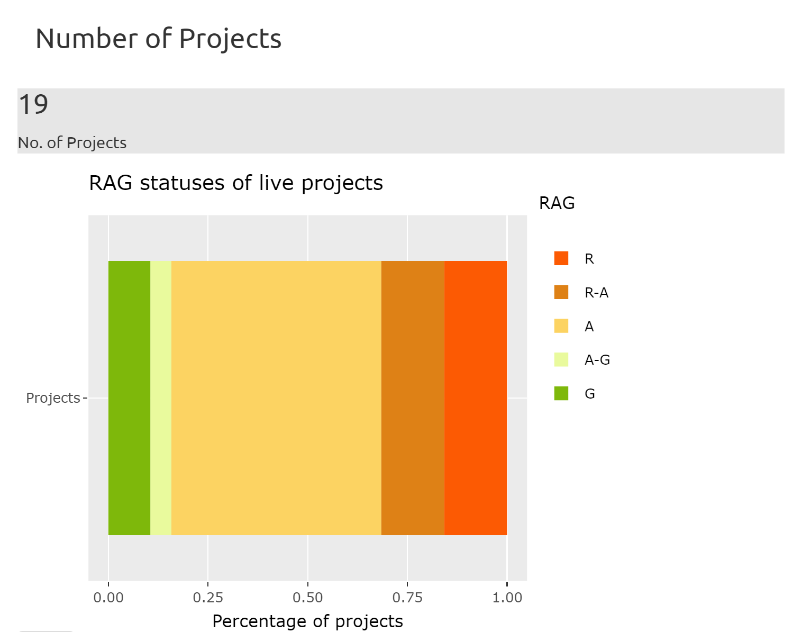
How does it work?
A graph showing percentage of projects sorted by RAG rating and to give a visual overview of how the team is performing as a whole.

Slide 8
Fixes/improvements needed to current model
Some names are overlapping so some changes need to be made with the visuals and the formatting
Currently someone who works across two teams is classed as working in a separate team i.e. Thomas Clements is listed as MIAU/SFA and not as MIAU and SFA. It would be nice to be able to list people as being part of multiple team

Slide 9
Possible other features
Some projects are incomplete and allocated to members who are no longer part of the team. Can we add in a way to flag this?

Slide 10
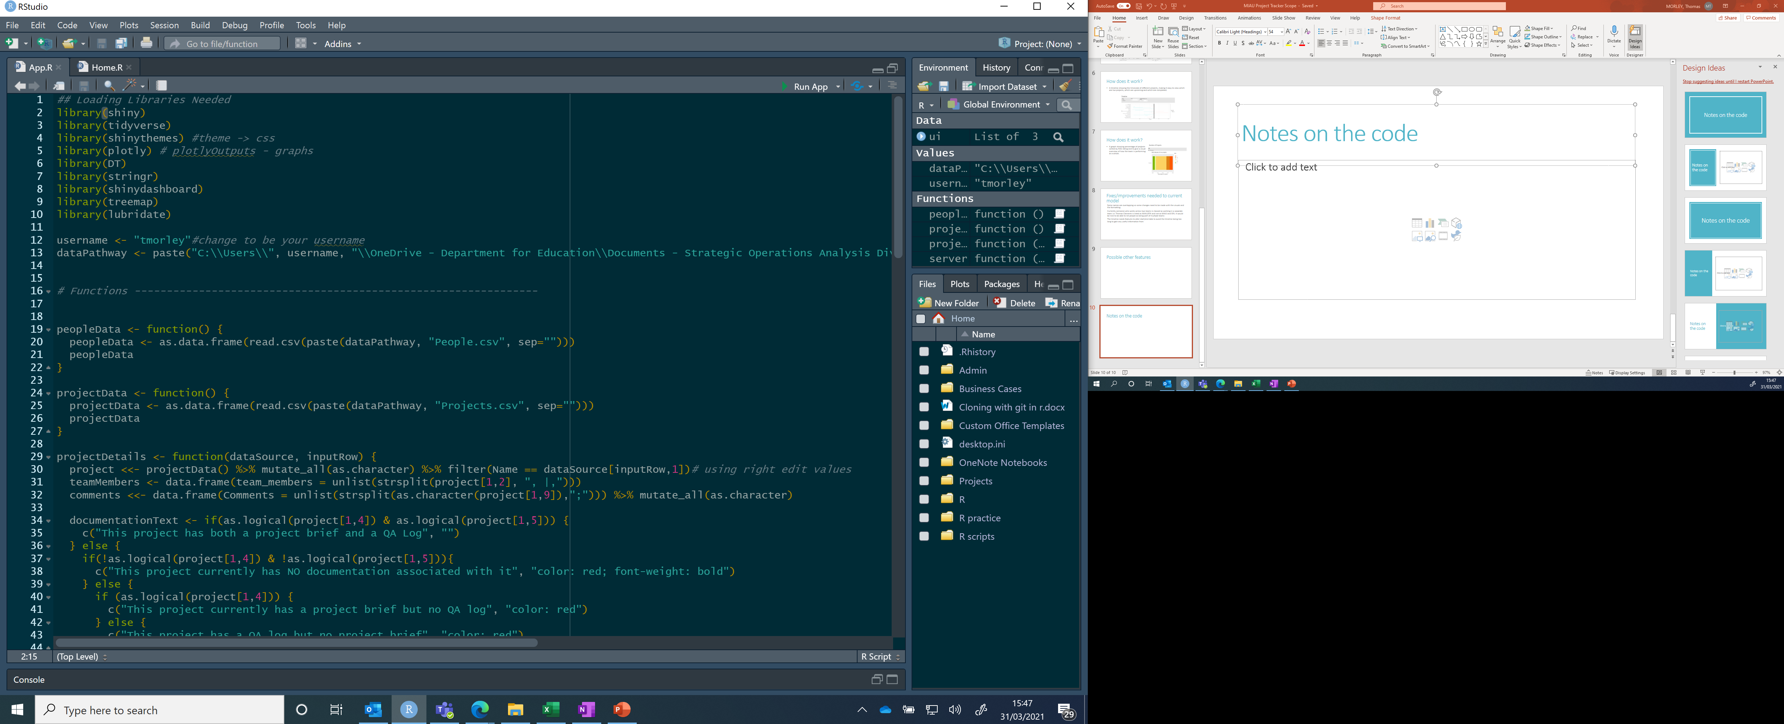
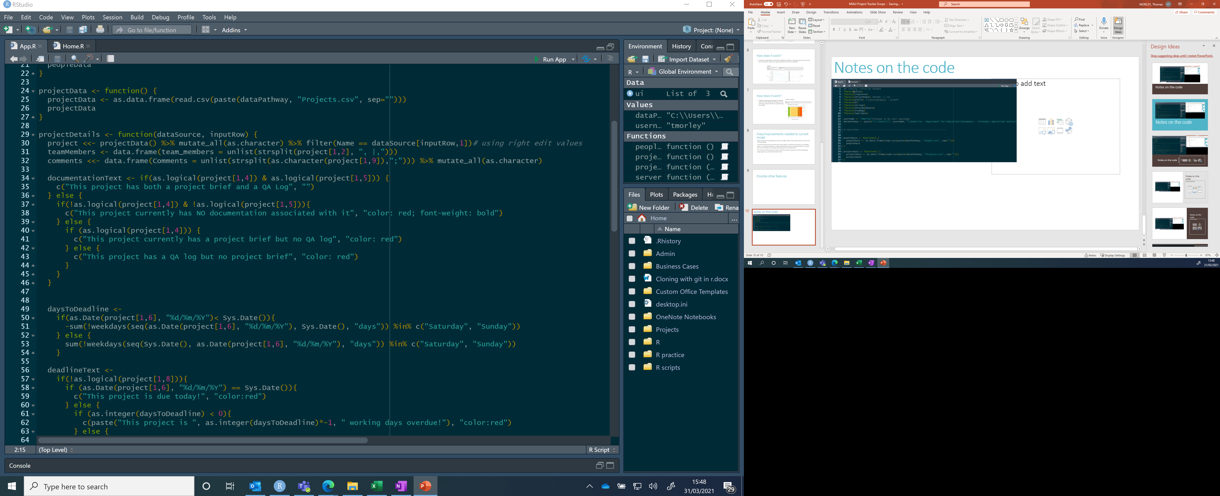
Notes on the code
App.R
Loads in relevant packages:
shiny creates apps in a html window
Tidyverse collection of R packages that assist with data manipulation (e.g. ggplot2, dplyr, etc.)
Shinythemes allows one to easily alter the appearance of the shiny app
Plotly allows plots to be interactive
DT allows filtering, pagination, sorting etc. in tables
Stringr provides a set of functions designed to make working with strings as easy as possible
Shinydashboard makes it easier to create a shiny dashboard with a header, a sidebar and a body
Treemap used to create treemaps to visualise proportions i.e. the graph depicting RAG ratings
Lubridate provides a consistence syntax that makes working with dates easy.
Username can be easily changed depending on who is working in the project. The directory is then set using the username to access the relevant folder in OneDrive.
The peopleData function reads in data from the People document. This contains names of people in the team, and which team they are part of.
The projectData function reads in data from the Projects document. This contains the names of each project, deadlines, RAG rating, etc.
The projectDetails function wraps the rest of the code. It uses inputs dataSource and inputRow
project contains all information from projectData (and then the other parts are all pulled from project)
teamMembers takes a list of team members on the project
Comments takes all comments for the project
Start of projectDetails function
Selects list of Team Members from second column in “Projects” document
Uses inputRow to select the project from the “Projects” document
If multiple Team Members are listed, this splits it into separate inputs
Selects comments from ninth column in “Projects” document
All comments combined into one string of characters?

Slide 11
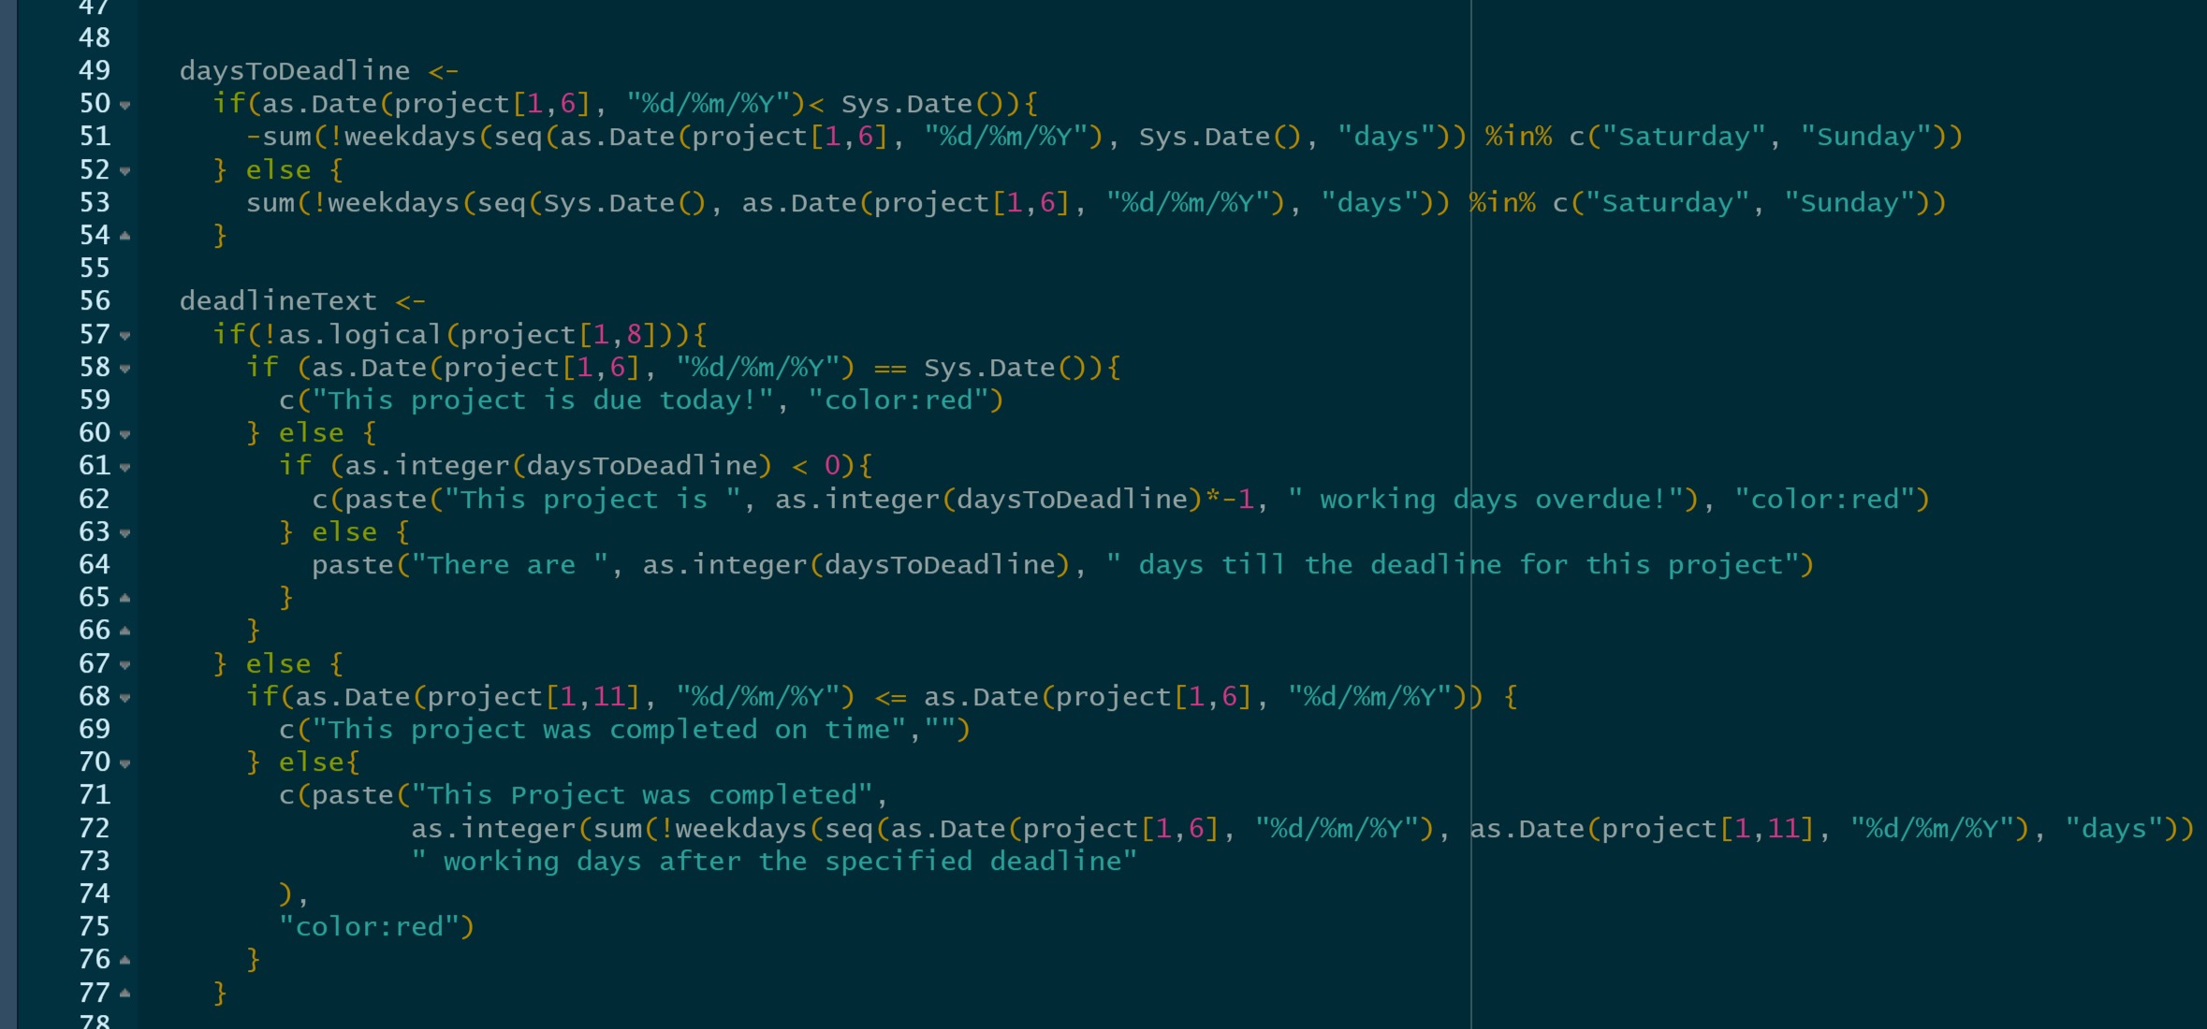
Notes on the code
App.R
Selects T/F values from 4th and 5th columns on “Projects” file
The documentationText function provides a line of text depending on whether the project has a project brief/QA log
daysToDeadline works out how many days between today and the deadline of the project (just weekdays)
deadlineText gives lines of text relating to whether the deadline has been met or not:
E.g. “The project is due today!”, “This project is x working days overdue!”, “This project was completed on time”, “This project was completed x working days after the specified deadline”
The If/Else function means that daystodeadline is positive if before the deadline, negative if after
If “Completed” = FALSE
If “Deadline date” = today
If there are negative days to deadline
If “Completed” = TRUE
If project was completed before or on the deadline (<=)

Slide 12
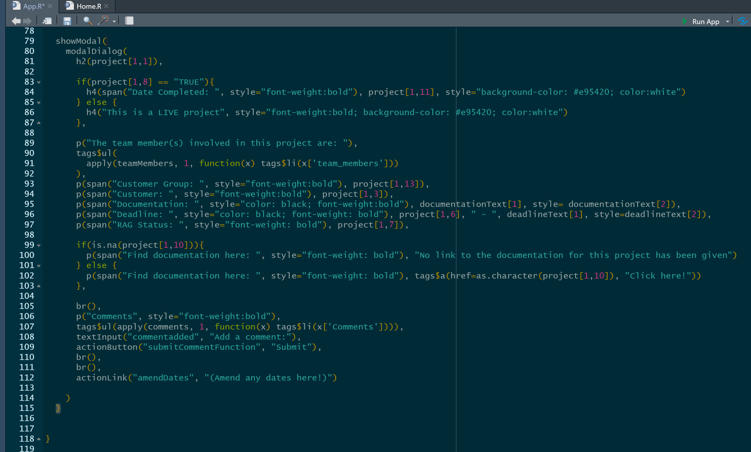
Notes on the code
App.R
A modal is a pop-up that is rendered within the original window.
This modal with give us the following data:
The name of the project, given as a header, taken from the Projects file.
If the project has been completed, this will give us the date of completion, otherwise will tell us the project is live. This is taken directly from the Project file.
The team members involved in the project will then be printed using the teamMembers function.
The Customer Group will be printed from the Projects file.
The Customer is printed from the Projects file.
The Documentation is given using the documentationText function.
The Deadline is printed from the Projects file, including the message given by the deadlineText function.
The RAG status is printed from the Projects file.
If there is no documentation linked within the Projects file, a message is displayed. If documentation is linked, then a link is given with a Click Here!
Br() inserts line breaks
Comments are inserted using the comments function.
There is a textInput option to add a comment, along with an action button to submit the comment.
There is an action link to amend any of the dates.
End of projectDetails function
This appears in the app when you click on a project name, and then click on “Project Details”

Slide 13
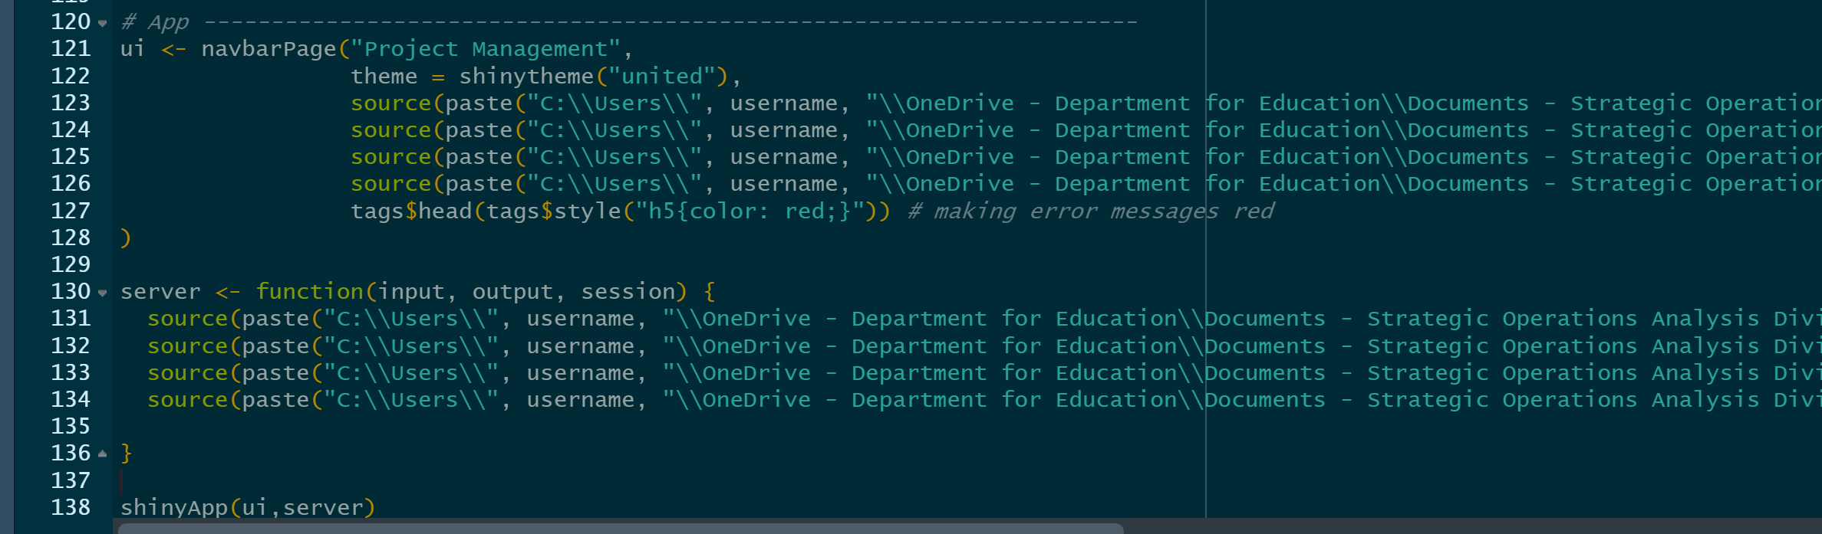
Notes on the code
App.R
This appears in the top right hand corner
The shinytheme is “united” – this gives the orange colour etc.
The ui gives us the navigation bar along the top of the app, with each of the different elements read in from the files in the ui folder.
This is presumably what “Teamoverview”, “personoverview” and “timeline” are for. Not sure what Home is for, but guess it’s for “edit info” tab
The server tells us about something else? Not sure what
The shinyApp command merges the ui with the server to build our app.

Slide 14
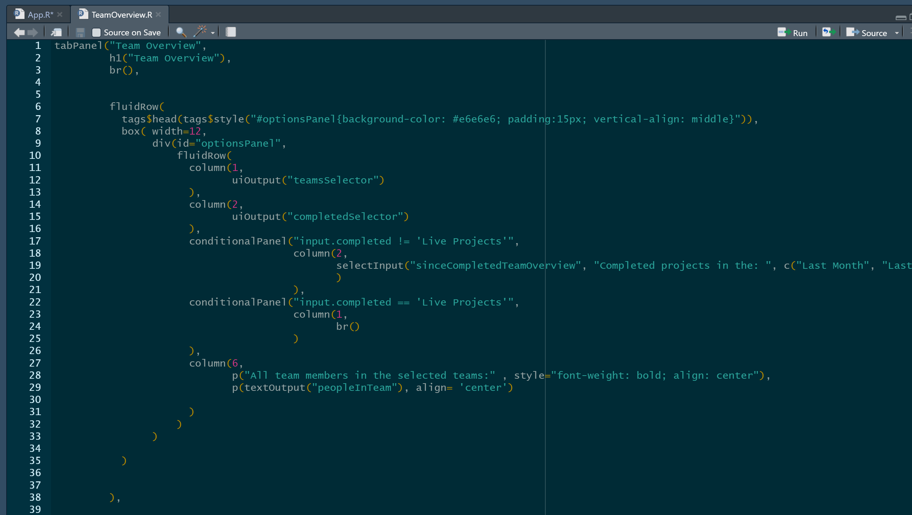
Notes on the code
Ui/TeamOverview.R
Tab is called “Team Overview”, this is what is seen in the navigation bar.
The next section gives the code for the box at the top of the tab, referred to in the code as the “optionsPanel”
There is uiOutput for “teamsSelector” and “completedSelector”. Not sure where these are defined. Possibly in server script?
There is some extra functionality here. If the “Completed Projects” option is chosen, then there is another column which appears which gives options to control when to view projects from. The output is given by “sinceCompletedTeamOverview”.
If the “Live Projects” is chosen, the next column is skipped.
The final column gives the last option, with outputs given from “peopleInTeam” (Is this defined from teamsSelector?)

Slide 15
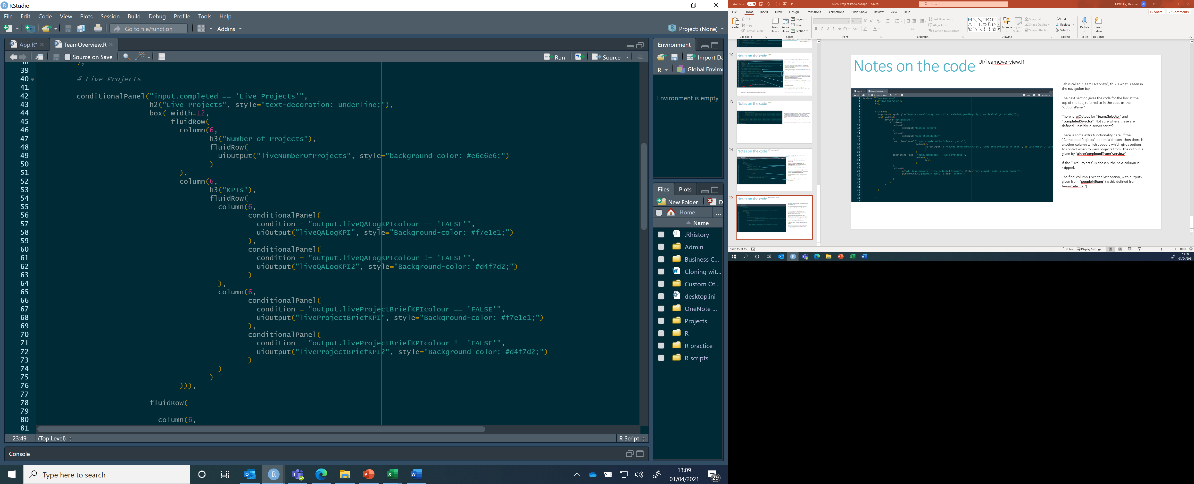
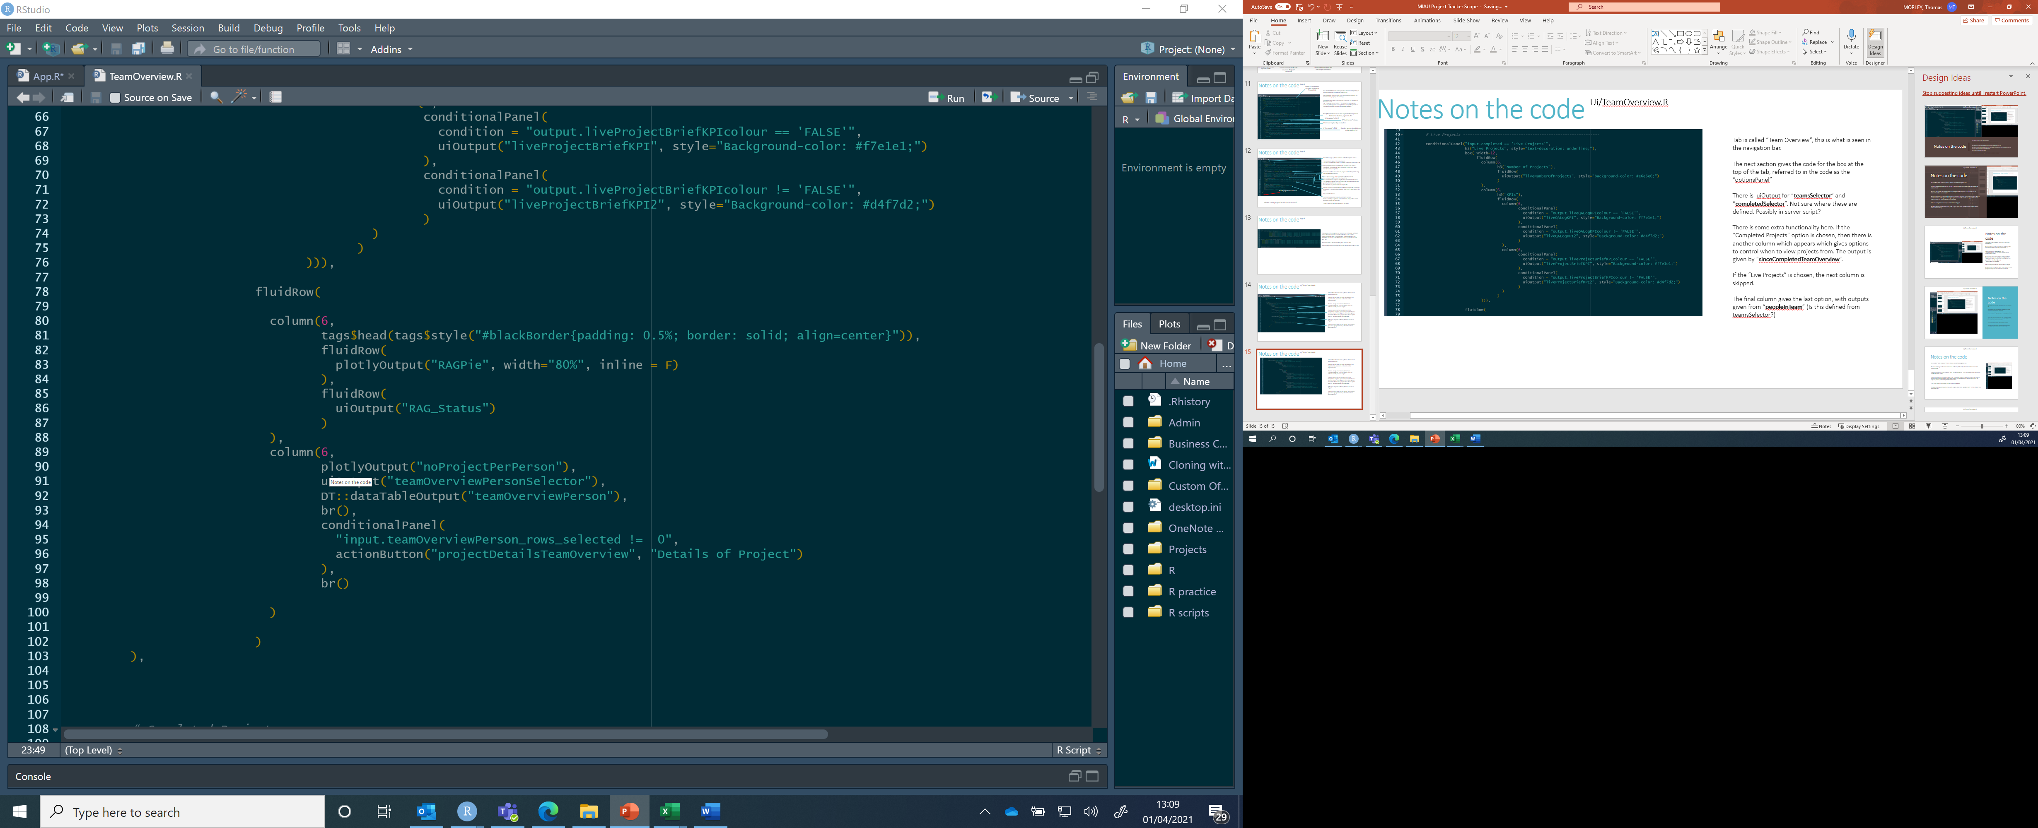
Notes on the code
Ui/TeamOverview.R
This is a conditional panel which only shows when Live Projects have been selected.
There is a ui output of “liveNumberOfProjects”.
The colour of the KPIs boxes change depending on the % of projects with QA logs and project briefs. This is given by the conditional panel, where the background changes depending on whether “output.liveQALogKPIcolour” is TRUE or FALSE.
Then we get the Plotly output “RAGPie” and the uiOutput “RAG_Status” (is this the table of projects sorted by RAG status at the bottom?)
Finally we get the PlotlyOutput “noProjectPerPerson”, followed by the uiOutput “teamOverviewPersonSelector” (which I guess is the table?).
This is set into a table using DT::dataTableOutput.
A conditional panel appears if one of the rows are selected, with an option to view Details of Project. This also happens in the RAG table, but for some reason it isn’t in this code?

Slide 16
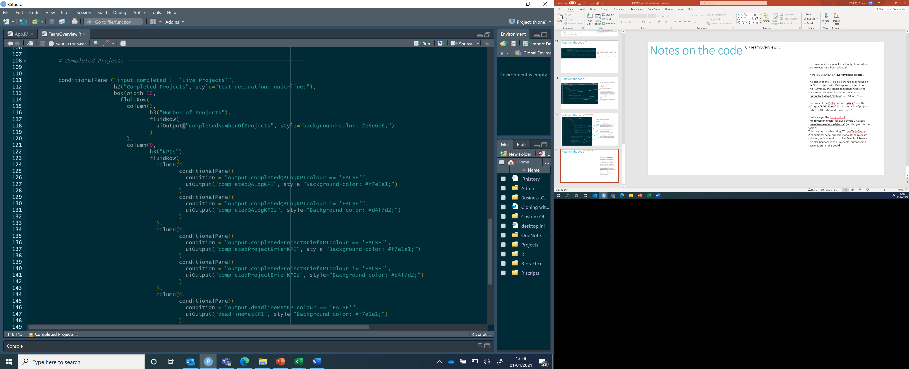
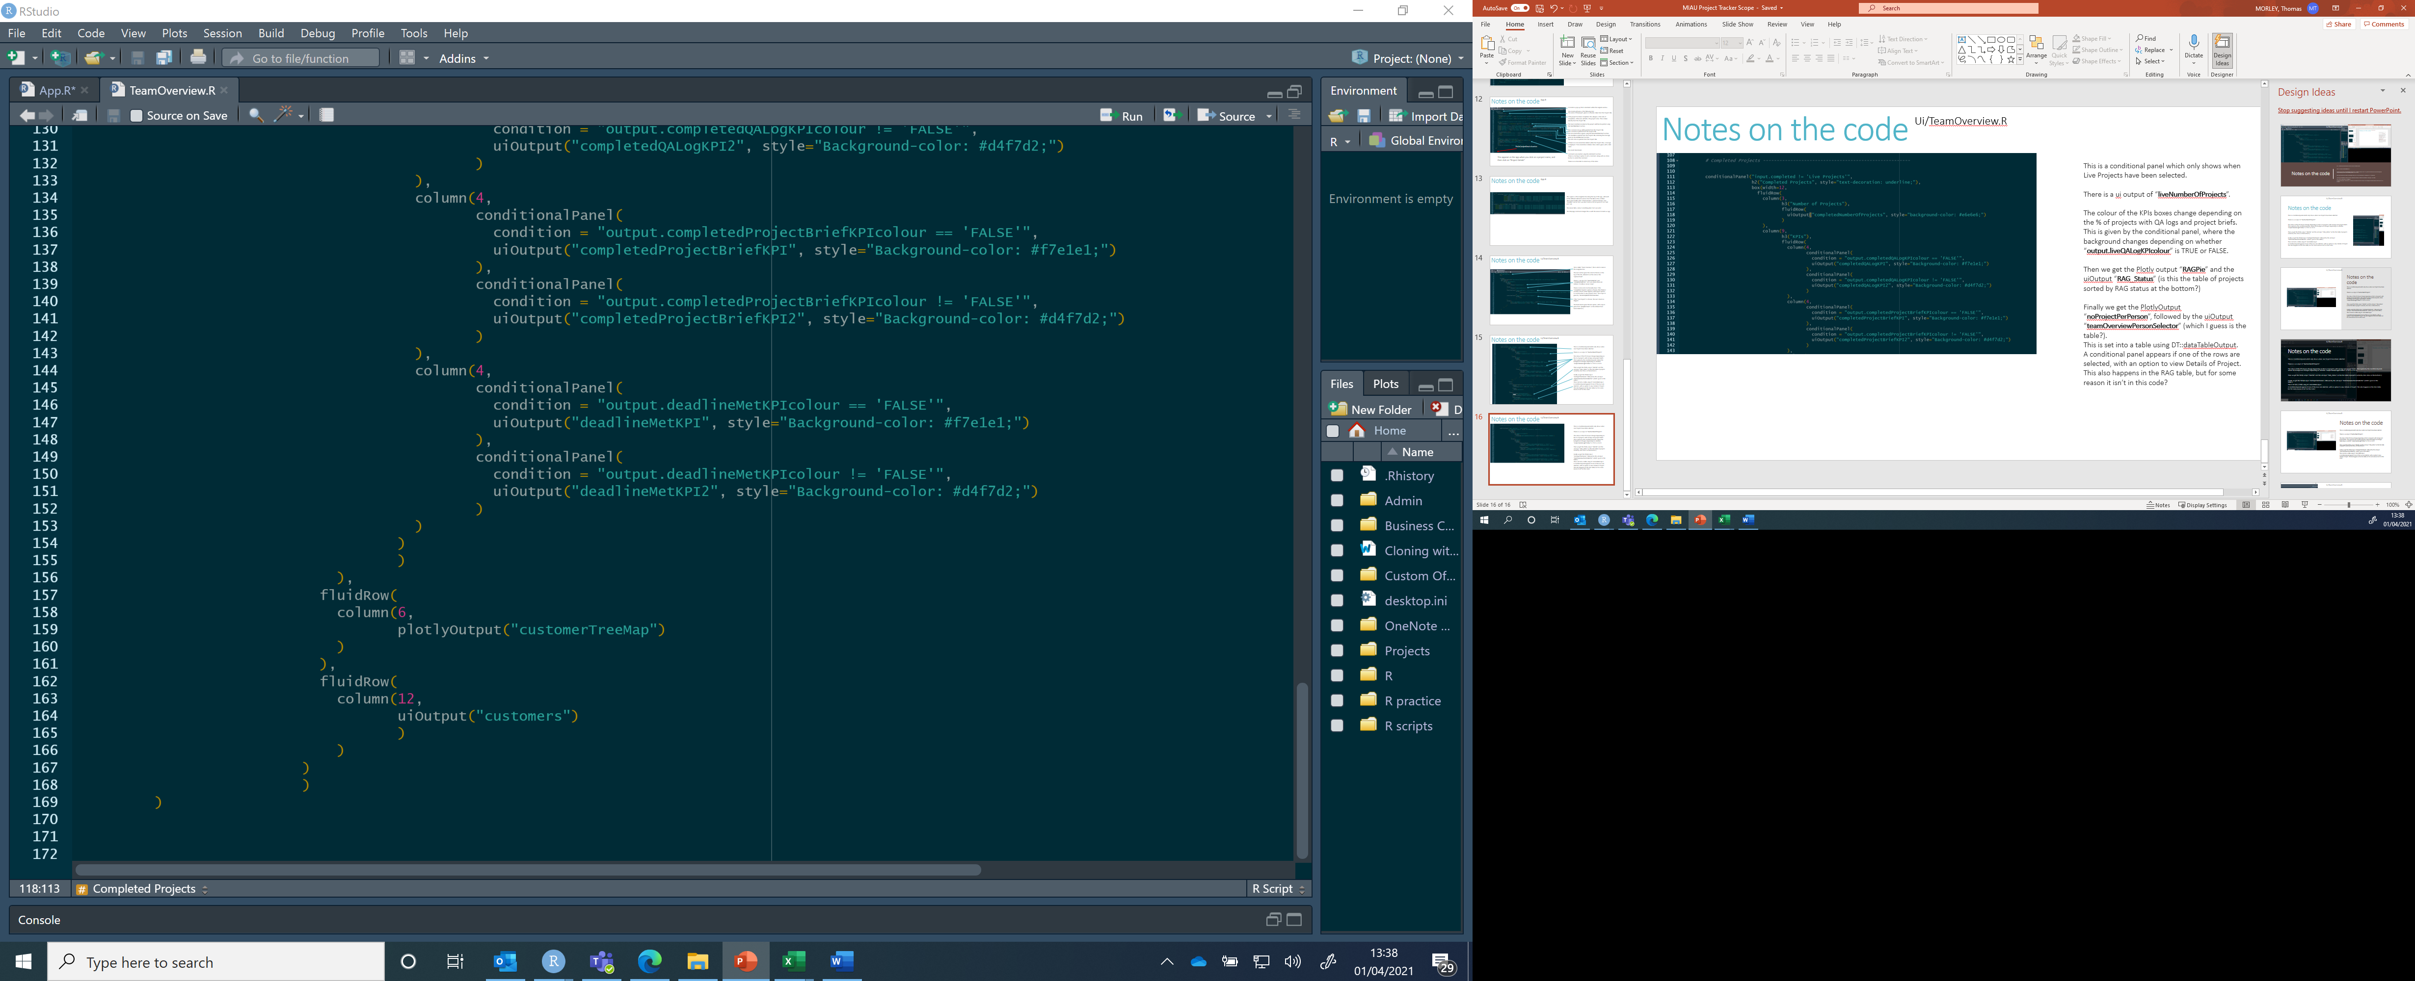
Notes on the code
Ui/TeamOverview.R
This is a conditional panel which only shows when Completed Projects have been selected.
There is a ui output of “completedNumberOfProjects”.
The colour of the KPIs boxes change depending on the % of projects with QA logs, project briefs and completed on time. This is given by the conditional panel, where the background changes depending on whether “output.liveQALogKPIcolour” is TRUE or FALSE.
Then we get the Plotly output “customerTreeMap” and the uiOutput “customers”, which is a table sorting the projects by customer this time.

Slide 17
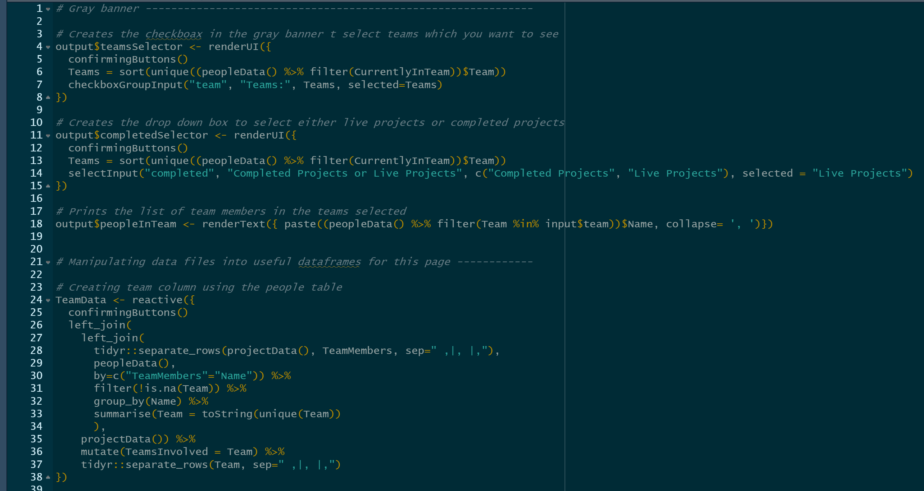
Notes on the code
Server/TeamOverview.R
This details the various objects that are displayed in the app via the UI. These are the objects seen in the previous notebook.

